Slide 1

Welcome to Nursling
We can not wait to start our adventure with you!

Slide 2
Meet the Senior Leadership Team
Head Teacher
Mrs Joanne Jearrad
Assistant Head Teacher
Mr Paul Booth
Assistant Head Teacher
Mrs Charlie Skeels
SENCO
Mrs Kate Mellor

Slide 3
What’s your vision for your child in school?
To be treated with love and respect
To become more independent
To make new friends
To become life-long learners
To learn through fun experiences
To have curiosity
To have opportunities to explore
To enjoy myself
To be happy
To be safe To be encouraged to do my best

Slide 4

Ofsted
‘The school values of love, hope and courage are the golden thread that joins all aspects of school life. Pupils know and demonstrate the school values. They know how these values help them with their learning and well-being. Pupils are happy and feel safe. Relationships between staff and pupils are warm and respectful.’
March 2025

Slide 5
We asked the children…
“You know you are responsible for your choices, actions and words. Does this help you to make better choices?”
It helps me to make the right choices.
It makes me think before doing something.
If I make the wrong choice, I know there will be a consequence and I will learn to make the right choice next time.
January 2026

Slide 6
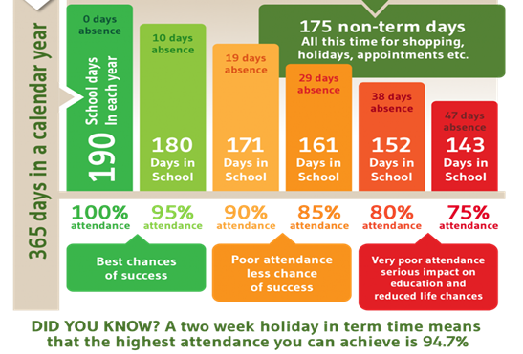
What will help your child to thrive at school?
Good Attendance
Routines
Support at home with
their learning
Parents working in
partnership with the
school

Slide 7
Meet the Team
Class Teacher/ EYFS Lead
Miss Steph Cubbon
Teaching Assistants
Miss Rachel Tuffin
Miss Ashley Holloway

Slide 8
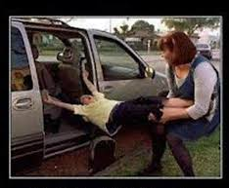

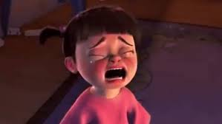

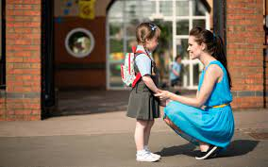
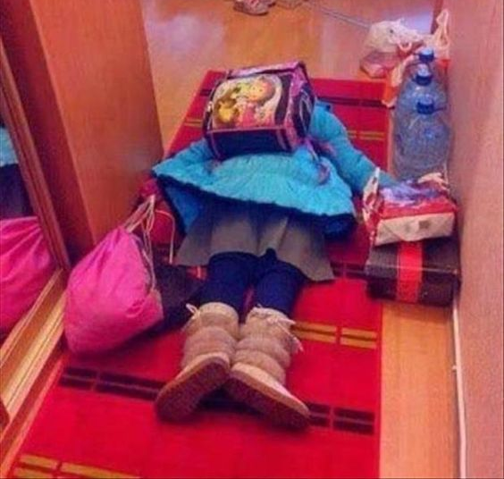
First Day of School
Happy
Stressed
Tears
Super Organised
Exhaustion

Slide 9
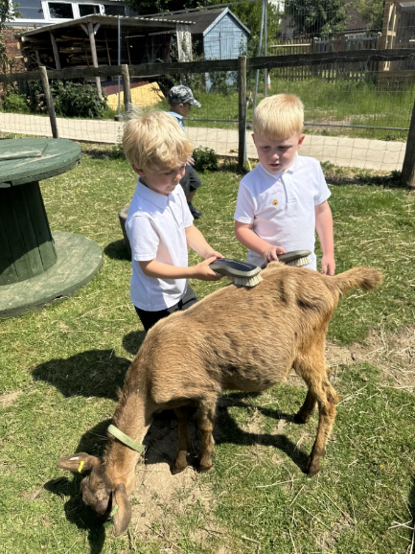
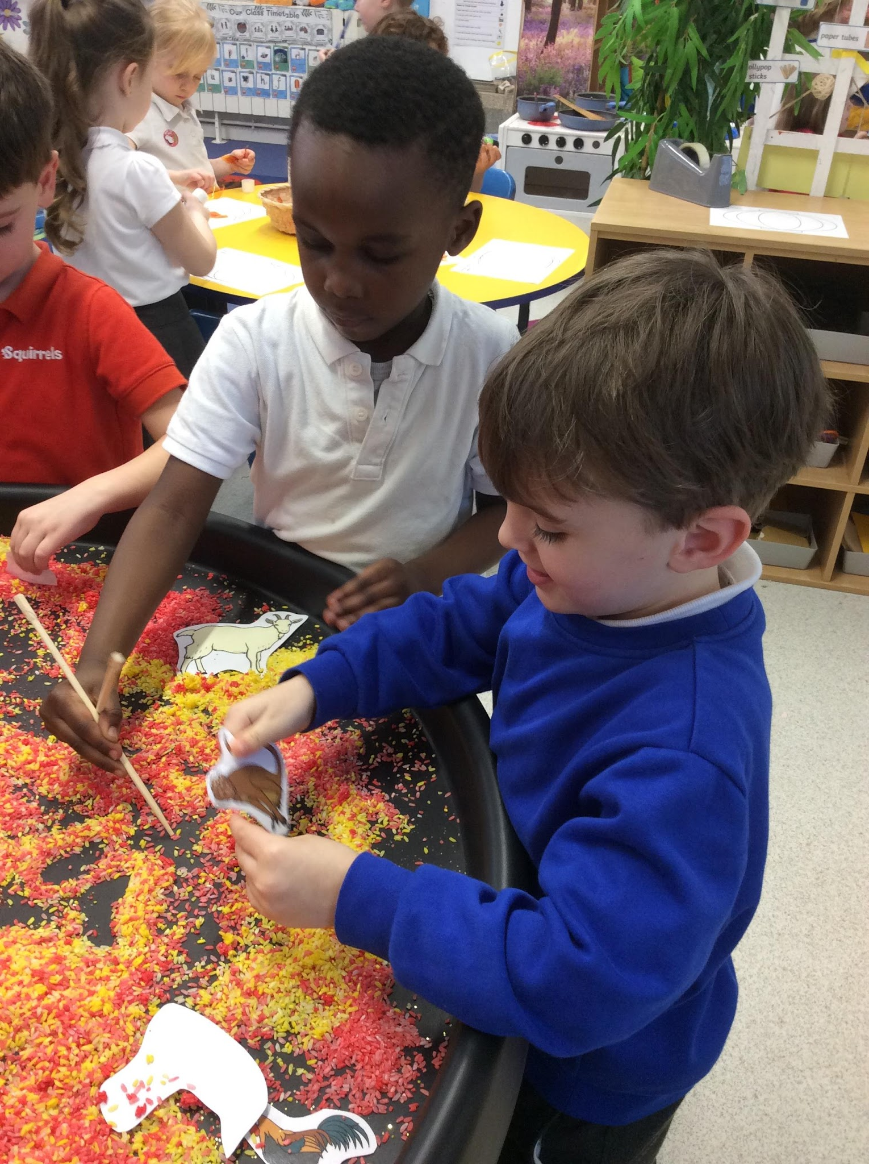
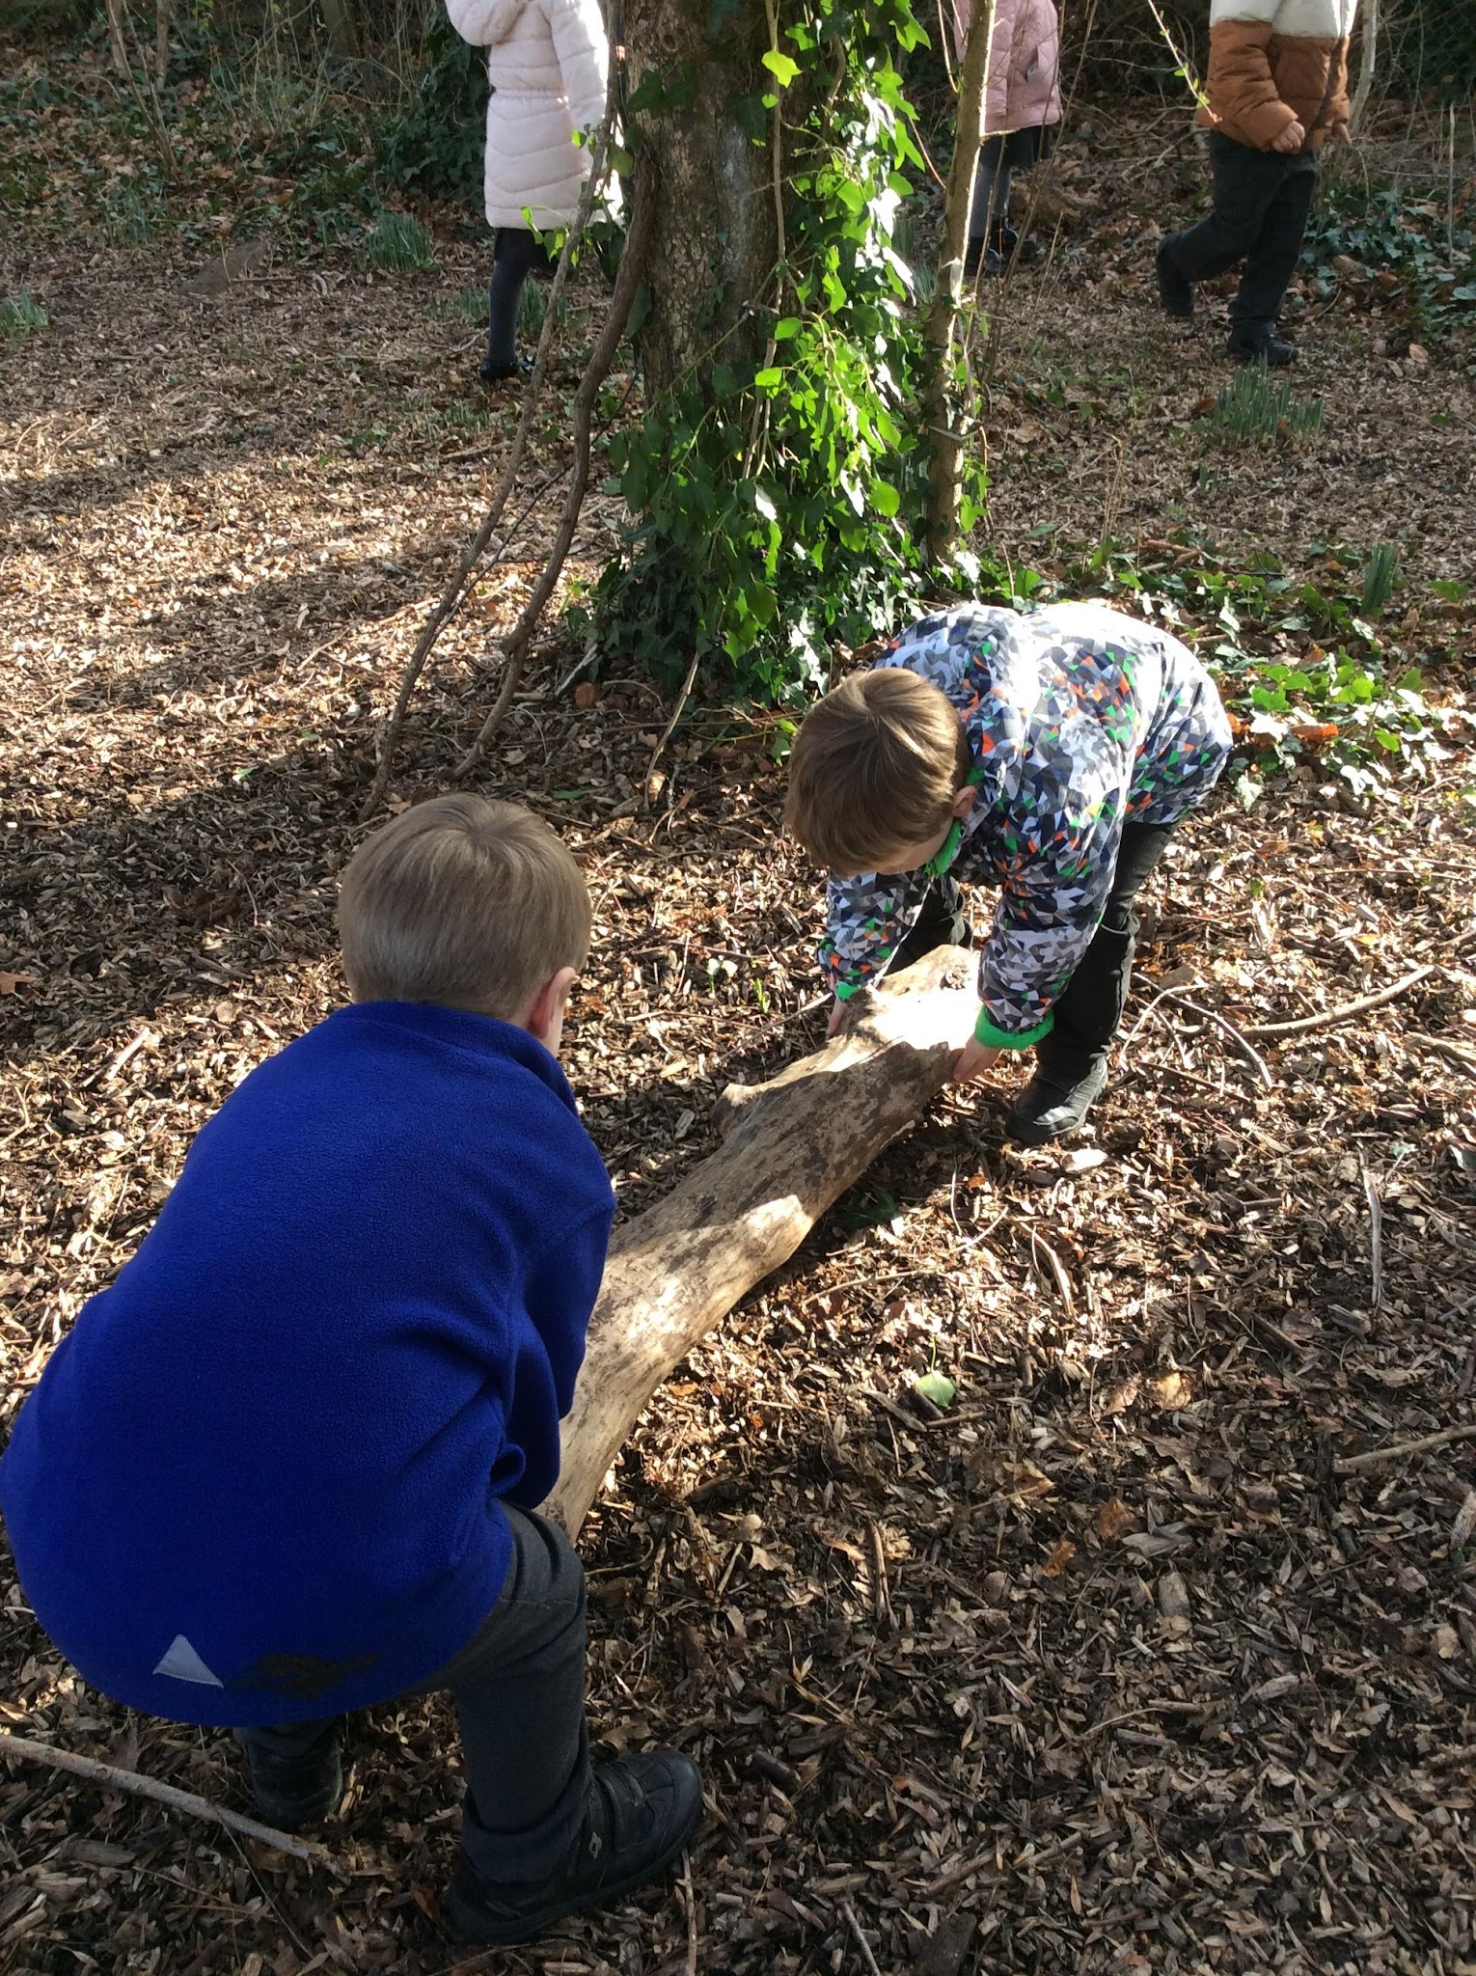
EYFS Curriculum
In Year R, the children will learn through play or Adult Guided activities. The Early Years Curriculum is designed to develop a strong foundation to learning.
Within the EYFS Curriculum there are:
7 Areas of Learning.
17 Early Learning Goals
3 Characteristics of Effective Learning
(Creating and Thinking Critically, Active Learning and Playing and Exploring)

Slide 10
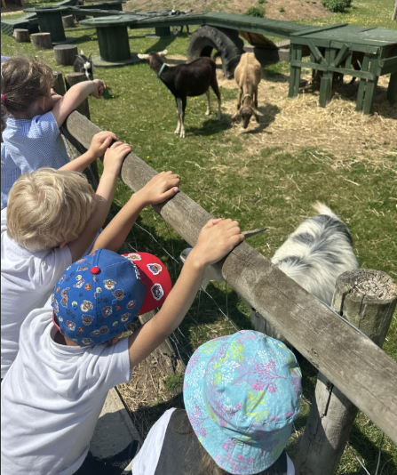
7 Areas Of Learning
Communication and Language
Personal Social Emotional Development
Physical Development
Literacy
Mathematics
Understanding the World
Expressive Arts and Design

Slide 11
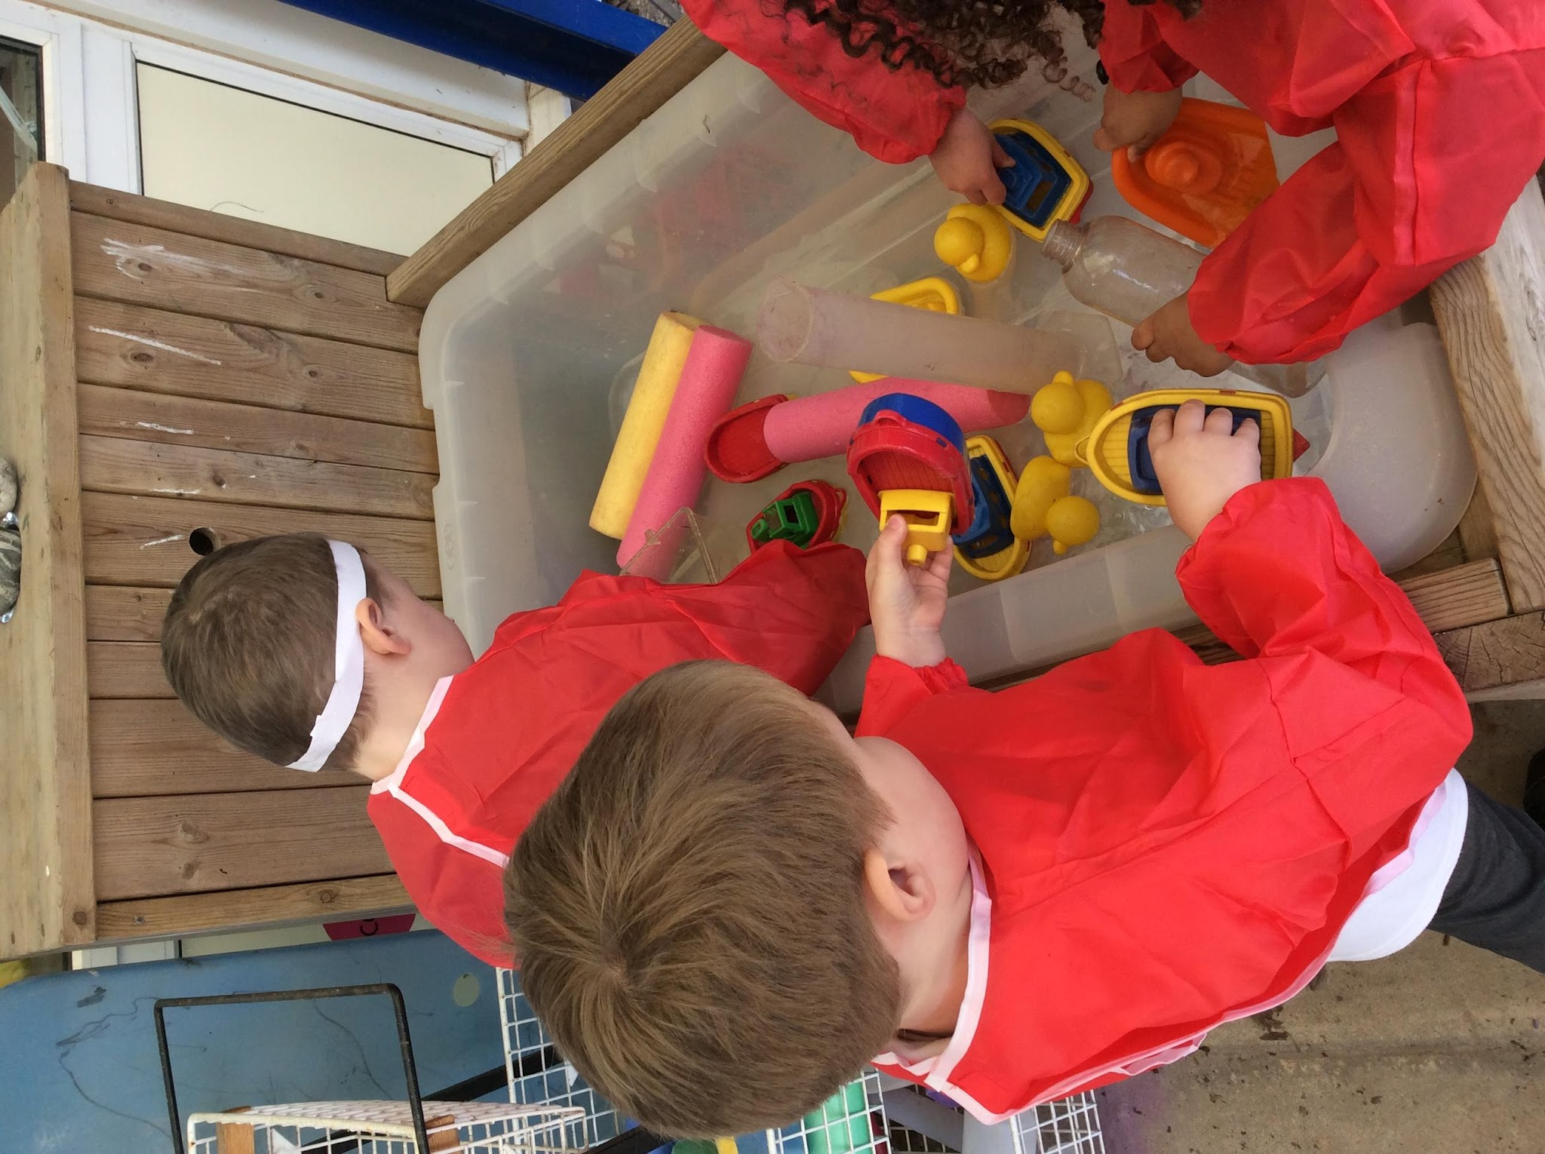
What does the school day look like?
8:40am- Classroom door opens and Morning Jobs.
9:00am- Register/ Dance/ Collective Worship
9:20am- Phonics
9:50- Toilet & Milk Time
10:15- Break
10:30- Maths
10:45- Discovery Time
12pm- Game and Toilets
12:10- Lunch
12:40- Lunch play
01:10- Register
01:30-Discovery Time
2:30- Story Time and Snack
3:15 Home Time

Slide 12
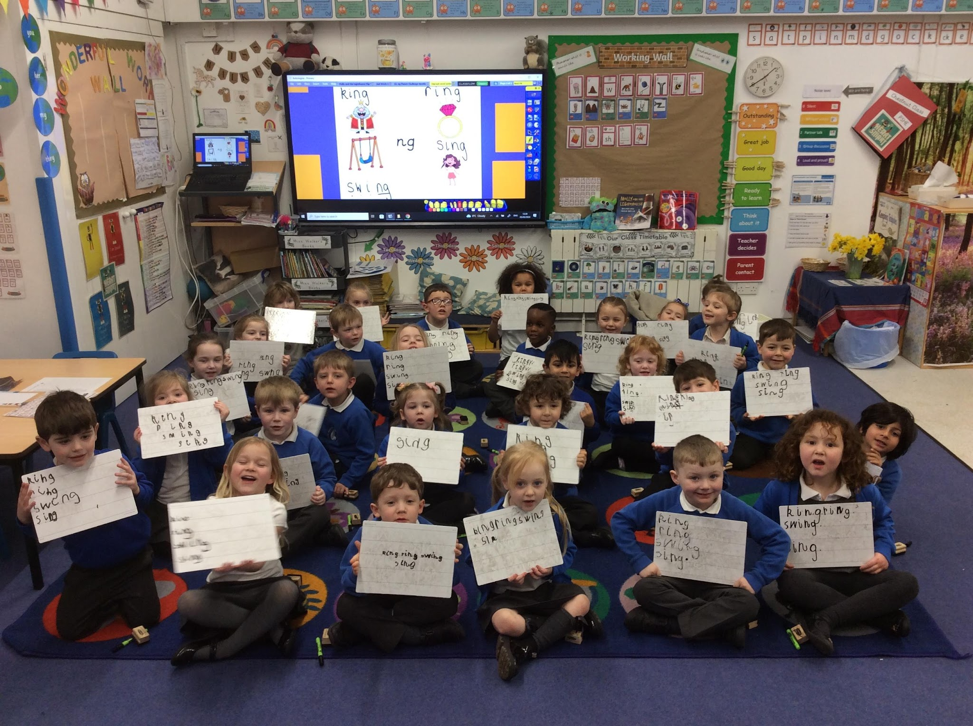
A Day in Chestnut Class
In Chestnut Class we follow a daily routine. Everyday we teach Phonics and Maths. This will be either whole class or small groups.
The children will have daily ‘Discovery Time’. This might involve them exploring outside, doing outdoor learning in our outdoor learning zones and welly walks. They will also have two PE lessons every week to explore movement, balance and interacting with each other.
The children will have ‘Discovery Time’ in the afternoon where they can show what they have been taught. This is free flow where the children have access inside and outside the classroom.

Slide 13

We aim to put at least one observation on Tapestry each week. During the Autumn Term this will be more as we are getting to know the children.
We expect parents to access Tapestry regularly and contribute. We love to find out what the children are doing over the weekend and holidays!

Slide 14


Slide 15

Is my child school ready?

Slide 16


School Meals, Snacks and Drink
Every child in EYFS and KS1 are entitled to free school meals.
Parents order children’s meal choice via Aspens App - Swift Kitchen
All meals are freshly prepared onsite daily.
Children are given free fresh fruit in school as part of a healthy snack.
All children who are aged 4 years old are given free milk in school every day. This stops automatically once the child turns 5 years of age.
If you choose to send your child in with a packed lunch, please ensure:
Healthy options only please as we are a healthy school.
We are a NUT FREE school.

Slide 17

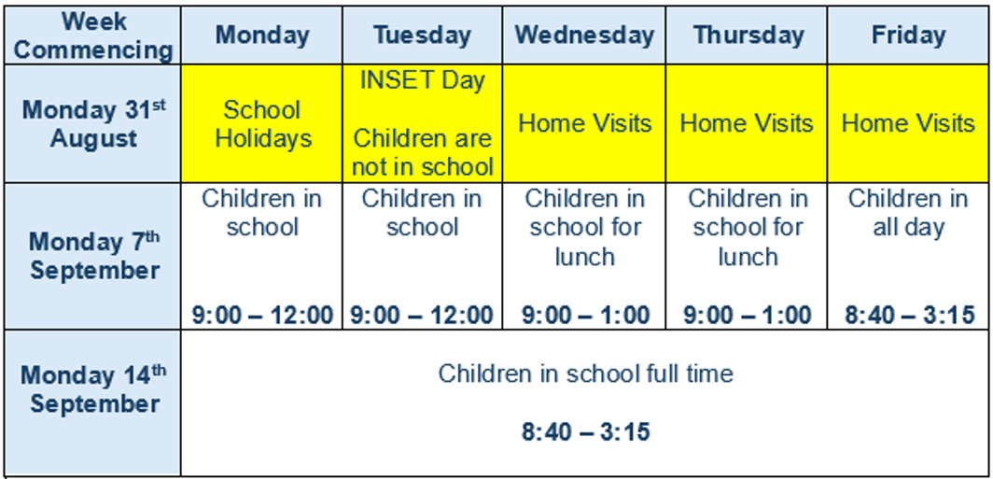
Starting School

Slide 18
Communication
The School office is open between 8:30am – 4pm, emails and phone calls will be answered during these hours.
Email: adminoffice@nursling.hants.sch.uk
Phone: 023 80 732 289
In Year R, communication occurs through Tapestry, Reading Record books or at drop off / pick up times at the classroom door.
For more in-depth queries or concerns, please make an appointment to speak to the class teacher via the school office.

Slide 19
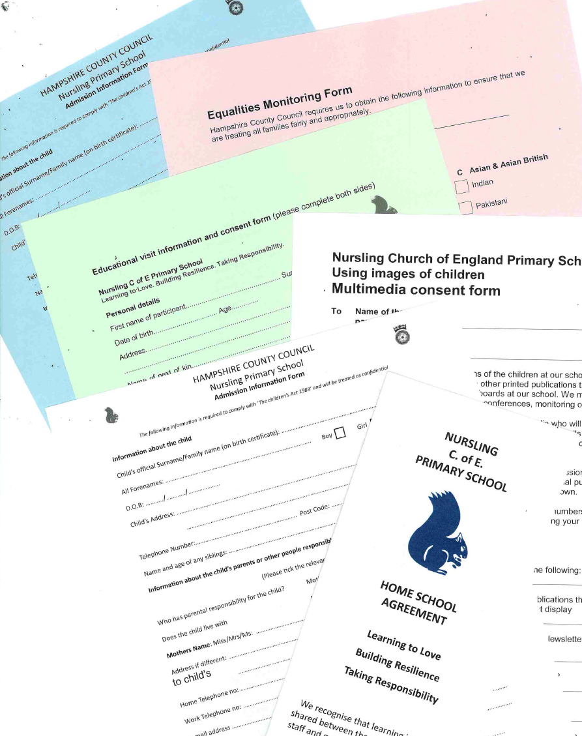
Completed Forms
Please complete and return the forms in your pack by Friday 3rd July

Slide 20
Stay and Play!
We are excited to invite you to a Stay and Play session on Wednesday 1st July.
The session will run from 11:00-12:00.
The children will have the chance to explore exciting activities in both our outside and inside classroom.
It is a “drop off” session where parents leave and the children stay.

Slide 21

SEND
What are Special Educational Needs?
A pupil has SEN where their learning difficulty or disability calls for special educational provision, namely provision different from or additional to that normally available to pupils of the same age.
We are an inclusive school, we strive to meet children at their starting points to ensure they reach their full potential.

Slide 22
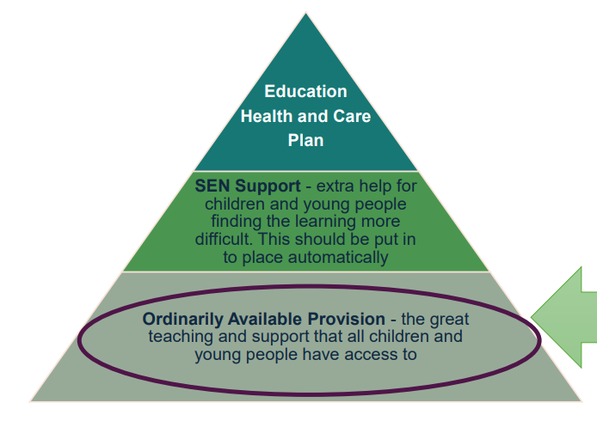
SEND
My role is to ensure that ALL staff have the skills to meet the needs of ALL children through the quality teaching they provide everyday.

Slide 23
SEND
“Pupils with SEND make strong progress over time. The school has procedures in place to quickly identify any pupil who has barriers to their learning. Teachers have high expectations for pupils with SEND and skilfully adapt tasks, when necessary, so they can access the curriculum alongside their peers.” Ofsted Report, March 2025.

Slide 24

After School Club

Slide 25
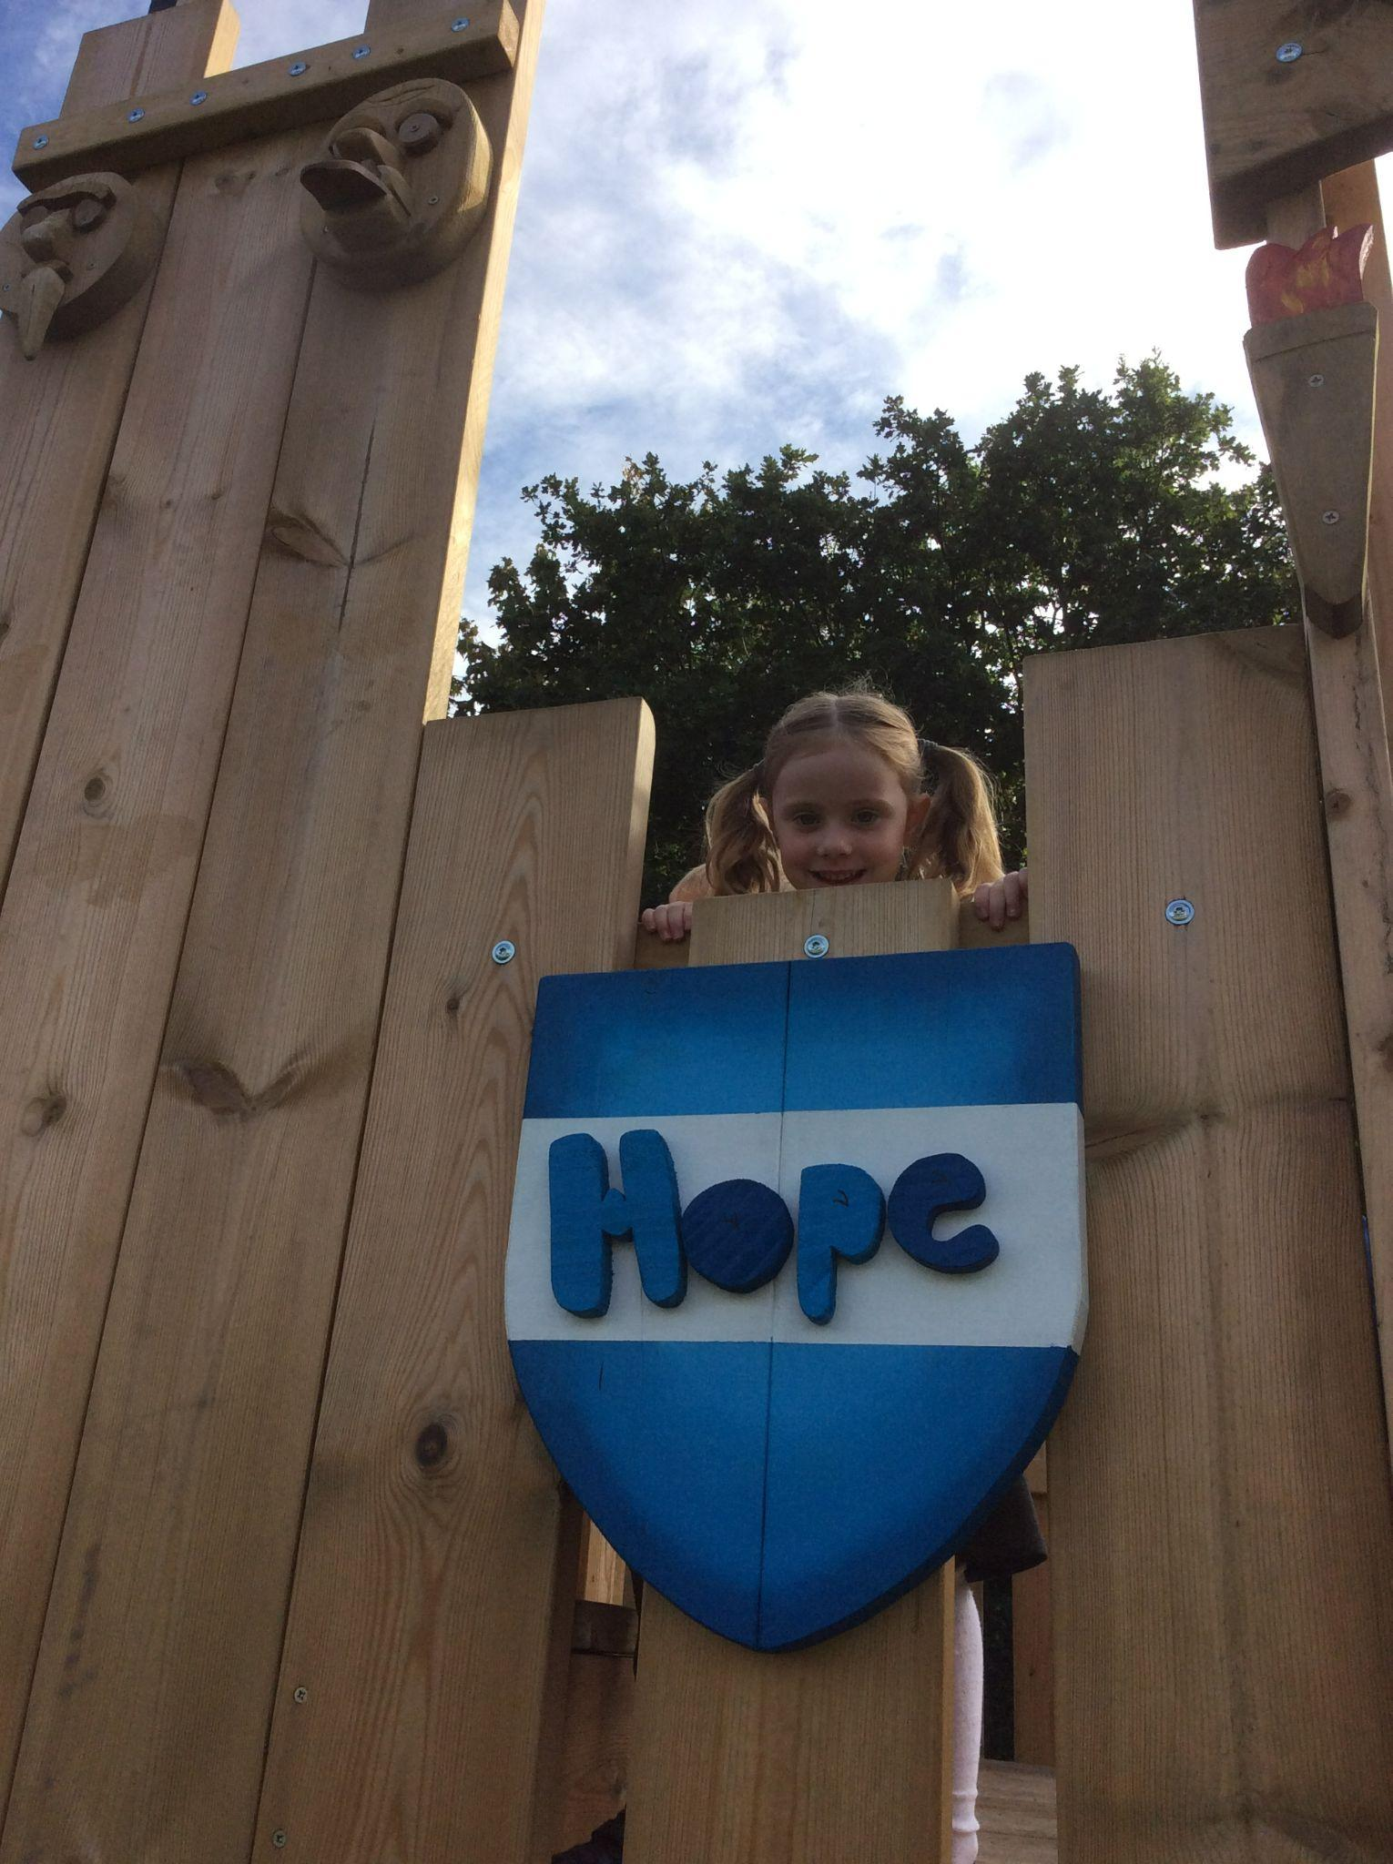
Who are the PTA?
Builds a school and community spirit.
An opportunity to share you skills, expertise and ideas.
Funds raised are used in a variety of ways to support the children. For example: New playground equipment, Outdoor Learning Space.
Providing support for events held e.g- the school disco, fete stalls.
Speak directly to a member of the committee.
Write a suggestion or question and pop it into the
PTA box.
Email- nurslingprimarypta@gmail.com
Facebook- www.facebook.com/nurslingPTA

Slide 26

School Nursing Team

Slide 27

School Uniform
Blue logo/non logo jumper/ cardigan.
Pale blue/ white T Shirt or shirt.
Grey or black skirt/ trousers/shorts.
Blue and white checked summer dress.
Book Bag (no backpacks please!)
Velcro or pull on trainers!
Plastic water bottle (not metal!)
PE Kit:
PE bag (no backpacks please!)
House colour T Shirt.
Black PE shorts/ joggers
Please ensure that every item of clothing is clearly named!

Slide 28
Question Time

